Slide 1

Measuring and Making Sense of the Internet for Everyone
Robbie Mitchell
mitchell@isoc.org
Notes:
My name is Robbie Mitchell, and I’m a member of the Internet Society.
I’d like to thank the organizers for giving us time to share our work and contribute to Internet measurement research and advocacy.

Slide 2


We believe everyone should have access to a trustworthy, resilient Internet that empowers and connects communities worldwide.
Notes:
At the Internet Society, we believe everyone should have access to a trustworthy, resilient Internet that empowers and connects communities worldwide. We seek to empower our 150,000 members and partners to achieve this.

Slide 3

Why we measure
To answer questions/validate beliefs
To set a baseline from which we can track change/show results
To demonstrate value
To justify decisions
To identify opportunities for improvement
Advance our knowledge
‹#›
Notes:
Part of this is providing them with data to help them understand the current strength of their Internet ecosystem and to track its progression or regression. Like anything, how can we validate or justify the value of the Internet without measuring it.

Slide 4
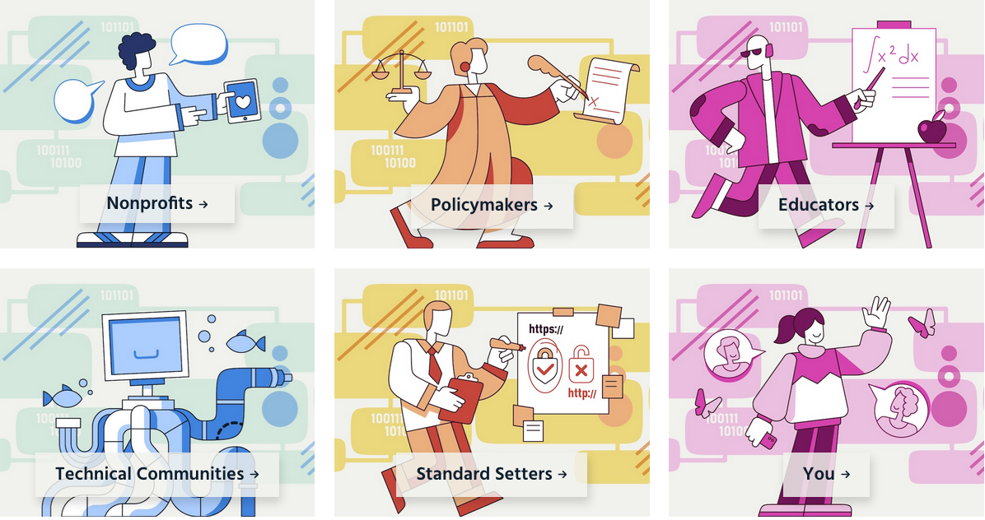
https://www.internetsociety.org/issues/internet-governance/who-runs-the-internet/
Notes:
Given the expansiveness of the Internet and its intertwinedness with society, no one person or group has a holistic overview or control over it. As such, multiple stakeholders need to work together to assess, advise, and advocate for keeping it open, globally connected, secure, and trustworthy. This multistakeholder community and others are the glue that holds the Internet together.

Slide 5

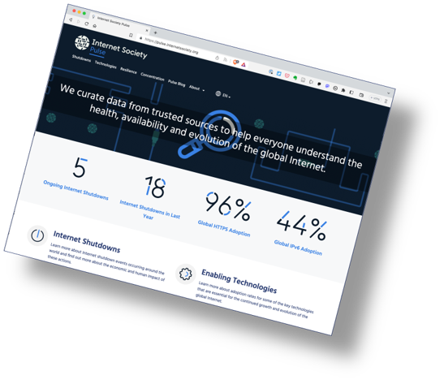
Internet Society Pulse
Launched in December 2020.
We curate Internet measurement data from trusted sources to help everyone gain deeper, data-driven insight into the Internet.
Trusted data from multiple sources:
Benefit: Helps to assess whether efforts to ensure that the Internet remains open, globally connected, secure, and trustworthy are working.
Benefit: Allows policymakers, researchers, journalists, network operators, civil society groups, and others to better understand the health, availability, and evolution of the Internet.
pulse.internetsociety.org​
Notes:
Since 2020, the Internet Society has been assisting these multiple groups to better understand the availability, evolution, and resilience of the Internet.
Through our Pulse website, we are consolidating trusted third-party Internet measurement data from various sources to provide actionable analysis and insights into:

Slide 6





Focus Areas
Enabling Internet Technologies
Internet Shutdowns
Internet Concentration
Interconnectivity and content locality
Internet Resilience
IPv6
TLS
DNSSEC
RPKI (ROA & ROV)
Artificial Internet shutdowns
Service blocking events
Economic loss
Local ISPs
Upstream providers
Data centers
DNS servers
CDNs
SSL Certificates
Hosting
IXPs
Data centers
Peering efficiency
Locally cached content
Infrastructure
Performance
Security
Market readiness
Notes:
The adoption rate of enabling Internet technologies
Where the Internet is being deliberately disconnected or censored, and the associated cost to the economy
Which countries and companies have the greatest market share in terms of connectivity and critical infrastructure, and services
And the interconnectivity, growth, and resilience of local, regional, and global networks.

Slide 7
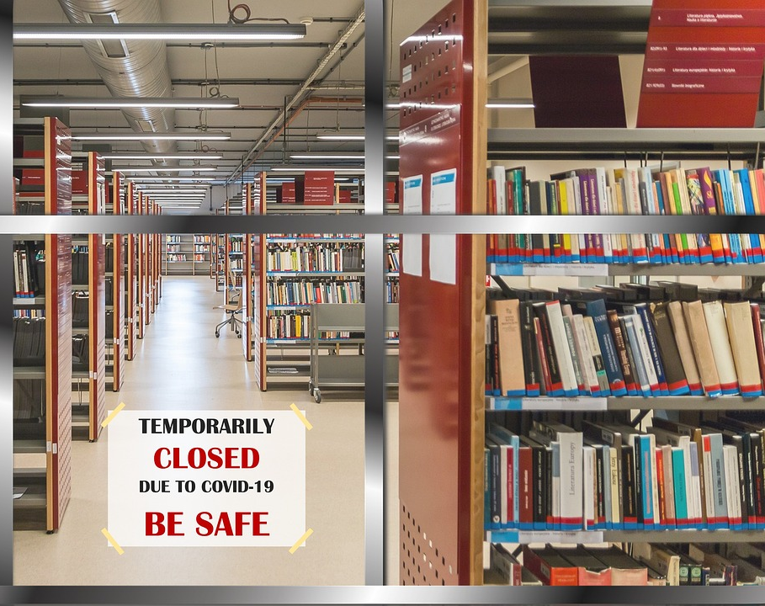
Resilience
A resilient Internet connection maintains an acceptable level of service despite faults and challenges to normal operation.
Notes:
When we talk about Internet resilience, we’re interested in how well networks can maintain an acceptable level of service when they experience faults and challenges to normal operation.

Slide 8
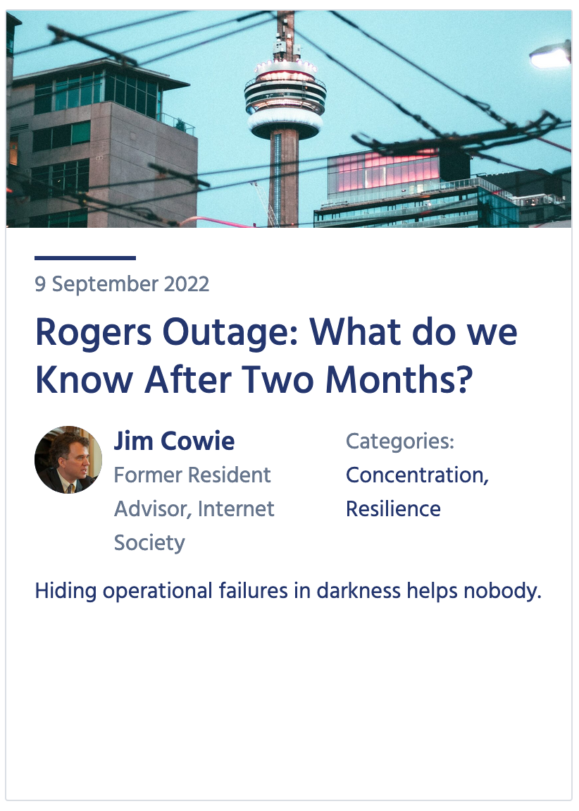
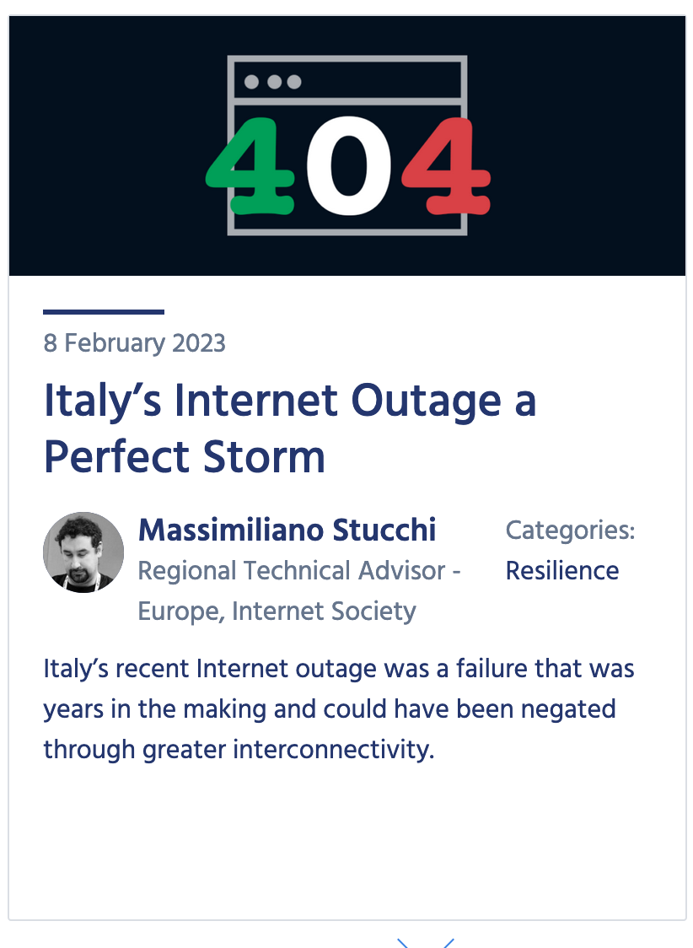
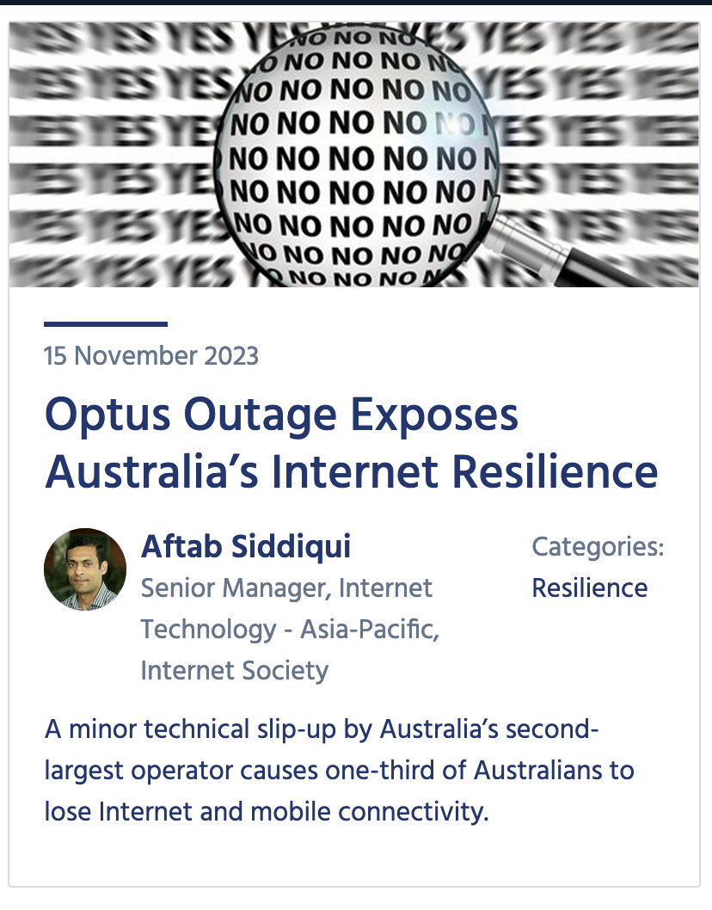
Not if, but when
Who’s next?
Canada, July 2022
Italy, February 2023
Australia, November 2023
Notes:
Note that I said when because it is common for networks to experience outages, whether malicious or accidental.

Slide 9
The Internet Resiliency Index (IRI)
The framework collates around 30 sets of public metric data that relate to four pillars of a resilient Internet:
Infrastructure
The existence and availability of physical infrastructure that provides Internet connectivity.
Performance
The ability of the network to provide end-users with seamless and reliable access to Internet services.
Security
The ability of the network to resist intentional or unintentional disruptions through the adoption of security technologies and best practices.
Market Readiness
The ability of the market to self-regulate and provide affordable prices to end-users by maintaining a diverse and competitive market.
Environmental/ Disaster [TBC]
The infrastructure and energy redundancy in place to offset climate change and disaster scenarios.
pulse.internetsociety.org/resilience​
Notes:
Again, understanding resilience requires taking a holistic view of the ecosystem.
The Pulse Internet Resilience Index tracks a range of indicators and assigns a weighted score for each country, measured out of 100.
The IRI enables comparisons between countries, regions, and sub-regions, with a balanced set of metrics that accounts for the Internet’s complex ecosystem and varied landscape.

Slide 10
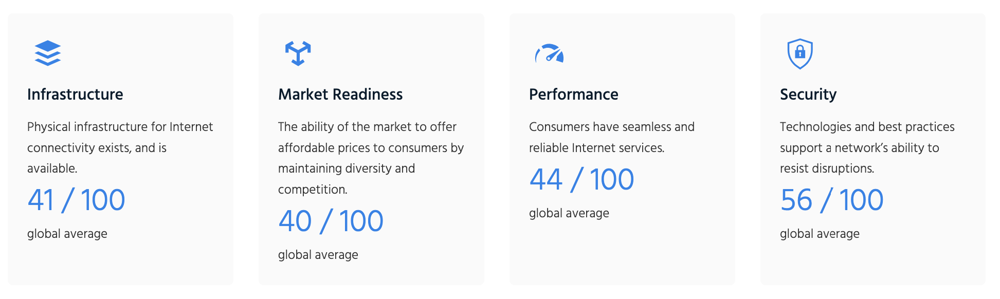
Internet Resilience — Globally
45/100
Overall global average
https://pulse.internetsociety.org/resilience
Notes:
So here we have the overall IRI score for the global Internet as well as scores for the four different pillars. You can see that Security has the highest resilience, and market readiness has the least.

Slide 11
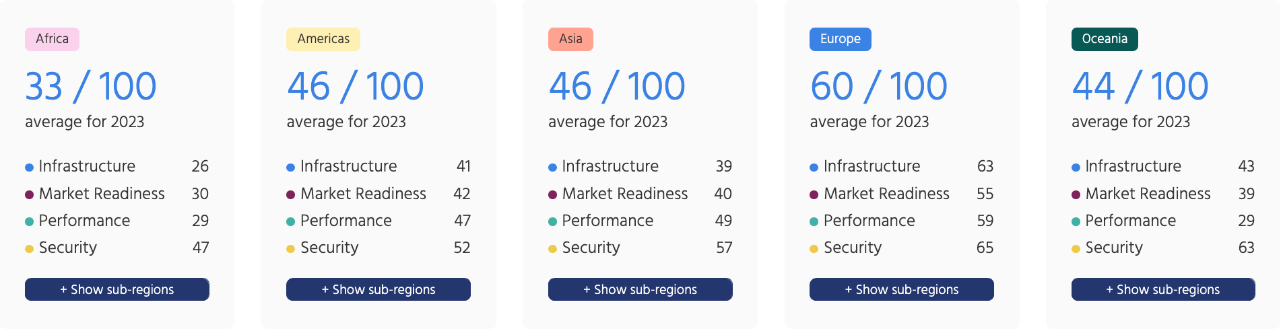
Overall Internet Resilience — By Region
https://pulse.internetsociety.org/resilience
Notes:
If we look at it for each region, we can see that Europe leads the way with Asia, the America’s and Oceania with similar resilience profiles, and then Africa with the least resilience.

Slide 12
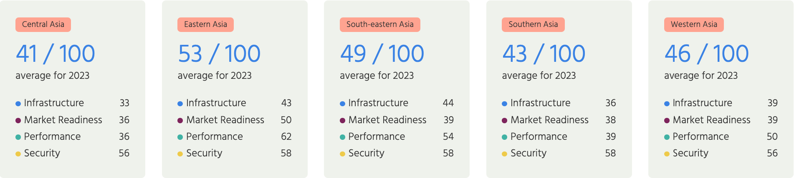
Overall Internet Resilience — By Sub-Region
https://pulse.internetsociety.org/resilience
Notes:
And within Asia, Eastern Asia has the greatest resilience, followed by South-eastern Asia and Western Asia.

Slide 13
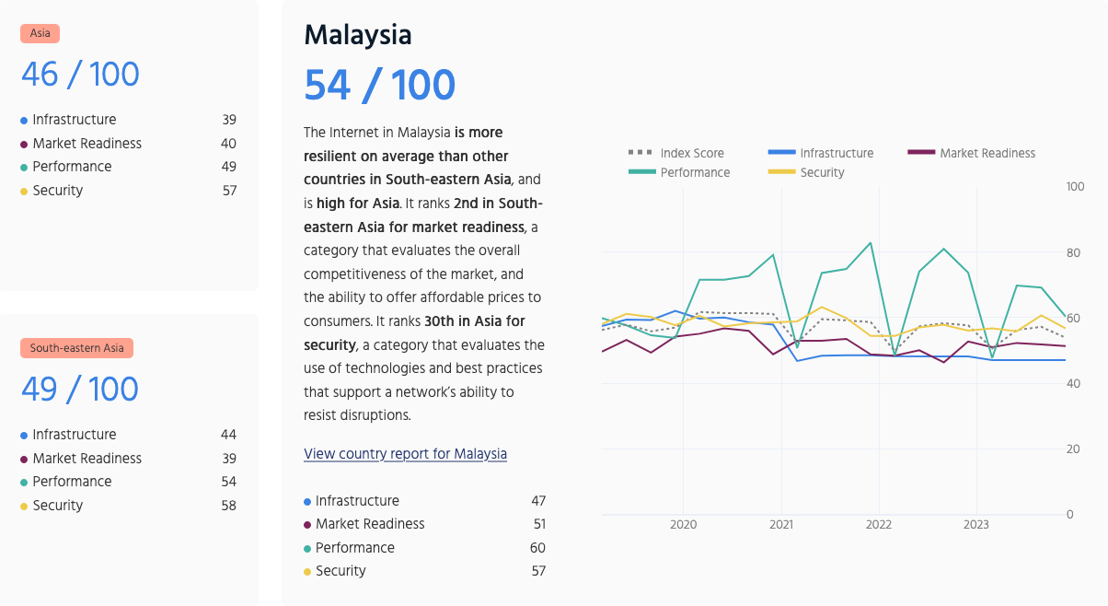
Overall Internet Resilience — By Country
https://pulse.internetsociety.org/en/resilience/my/
Notes:
If we look at Malaysia’s IRI profile, we can see its score is higher than the average for Asia and South East Asia. This is thanks to its impressive performance and security pillars.

Slide 14
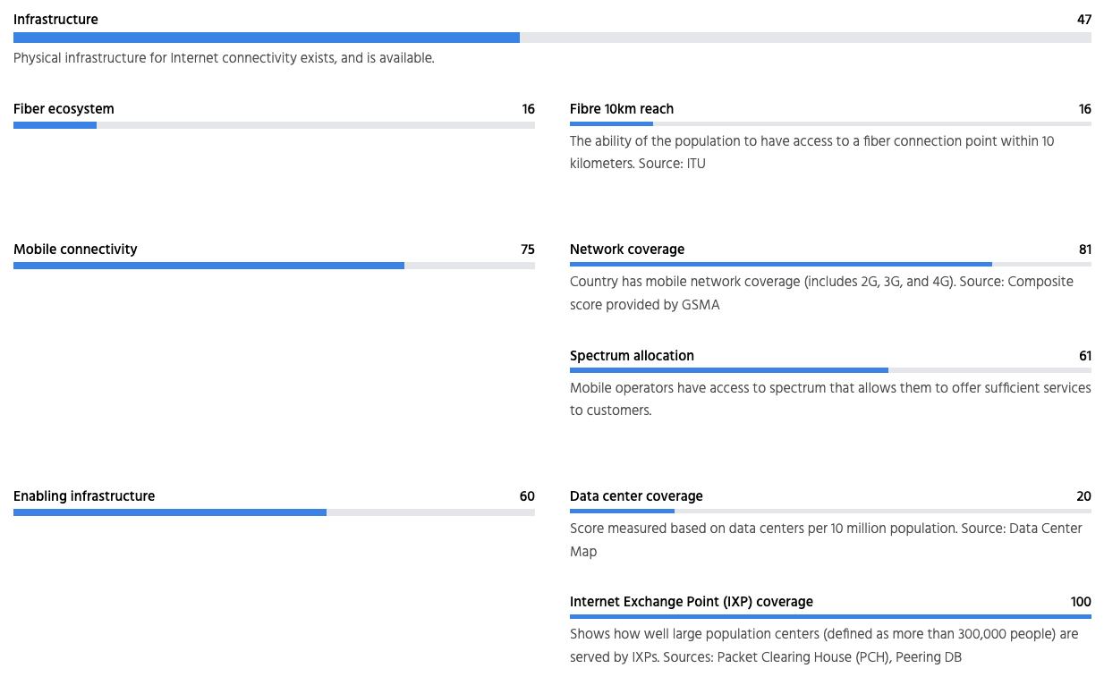
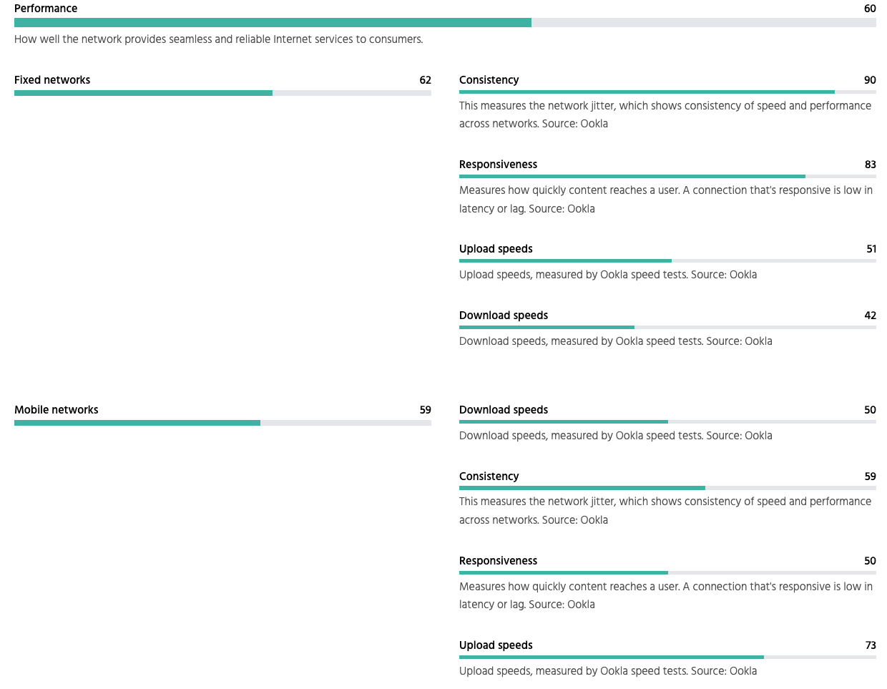
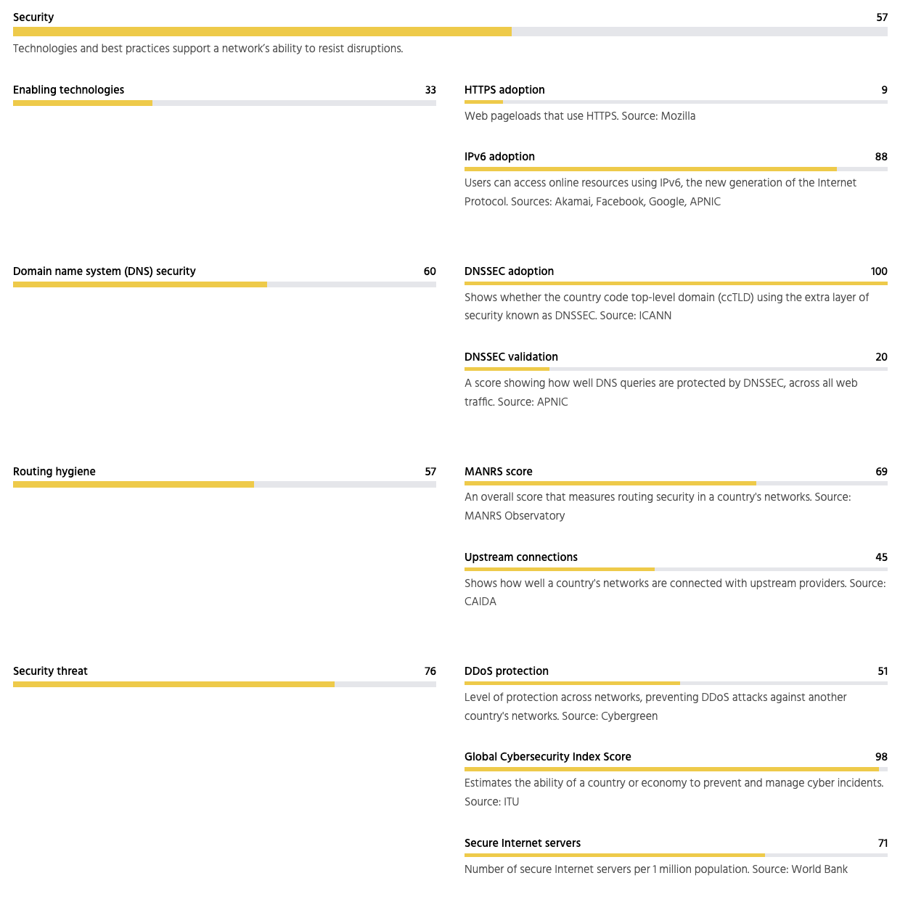
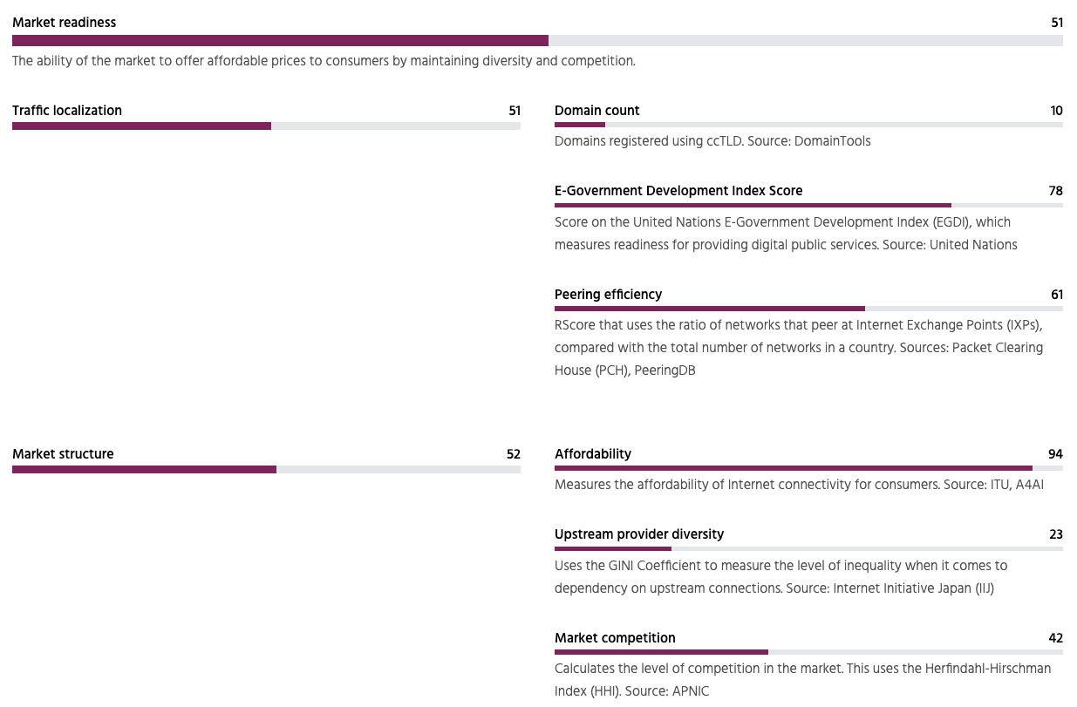
Malaysia– Internet Resilience Index
https://pulse.internetsociety.org/en/resilience/my/
Notes:
If we dive deeper, we can see in more detail Malaysia's successes and progress.

Slide 15
Malaysia– Internet Resilience Index
https://pulse.internetsociety.org/en/resilience/my/
Notes:
We can also see there are an equal number of areas that it can improve.
I won’t go into the details of these metrics and by no means do we say use this as the source of truth.

Slide 16
Limitations
The data is pulled from external public sources, not always up-to-date.
An indicator is not included if data is missing on more than 25% of countries in the Index.
Without in-country measurements, it’s difficult to validate the data.
RIPE Atlas and OONI are doing great work in this area, but more is needed.
Some of the data undergoes processing, normalization, and weighing, we use a methodology that is reproducible.
You can see raw numbers via API. Email us for access pulse@isoc.org
Ultimately, the Index benchmarks countries with one another and helps decision makers recognize gaps and weaknesses to conduct further study into validating these and work towards addressing them.
Notes:
What we are providing, though, is a digestible view of what is going on to help you, and especially decision makers, identify weaknesses and then hopefully do your own research to validate if what these measurement systems are seeing is accurate.
To this point, we advocate for greater localized data sourcing and sharing, which provides greater resolution to what is really happening at the edge.
As my fellow panelists will touch on, having an independent indigenous measurement system also provides consumers with a collective source of truth to:
Help them identify why they can't access the Internet or certain websites
Support their claims for remittance due to a lack of service
Advocate for better connectivity in their area.

Slide 17
We all have a role to play
Notes:
After all, we all have a role to play in developing and maintaining a trustworthy and resilient Internet.

Slide 18


Subscribe, Review, Contribute
Subscribe to the Pulse newsletter
Read the Pulse IRI methodology
Contribute to Pulse pulse@isoc.org
Notes:
If you’re interested in our work, sign up for our monthly newsletter and join our growing community of research fellows and partners as we all work to improve our visibility and understanding of the availability, evolution, and resilience of the Internet.

